Slide 1

Housing Price Prediction using Machine Learning and Data Visualization Techniques
Members :
Azahar mahaboob

Slide 2
Agenda
# INTRODUCTION & OBJECTIVE
# DATA OVERVIEW
# IMPORTING DATA & LIBRARIES
# DATA CLEANING
# STATISTICS
# HYPOTHESIS TESTING
CORRELATION ANALYSIS
ANOVA (Analysis of variance)
# DATA VISUALIZATION
# ML MODELS
LINEAR REGRESSION
RANDOM FOREST
DECISION TREE
# CONCLUSION

Slide 3

Introduction
Housing markets are dynamic and influenced by a wide array of factors, ranging from location and property characteristics to broader economic trends. Accurately predicting housing prices is a complex task, but it is essential for stakeholders such as real estate agents, investors, buyers, and policymakers. This project focuses on predicting housing prices for properties in Melbourne, Australia, utilizing a combination of data analytics and machine learning techniques.
The primary objective of this project is to develop a robust machine learning model that accurately predicts housing prices based on various features provided in the dataset. These features include property characteristics such as the number of rooms, building area, and suburb, among others. By leveraging these features, the model aims to generate price predictions that are close to real market values.
This project not only showcases the power of machine learning in solving real-world problems but also demonstrates the importance of thorough data analysis and model evaluation to derive actionable insights.

Slide 4

Data OVERVIEW
The dataset used for this project is sourced from the Melbourne Housing Snapshot available on Kaggle. It contains 13,580 rows and 21 columns, which represent different aspects of real estate properties.
The key features in this dataset include:
Bathroom: Number of Bathrooms.
Car: Number of car parking spots.
Suburb: The location of the property within Melbourne.
Rooms: The number of rooms in the house.
Type: The type of property (House, Unit, etc.).
Price: The actual price of the property (this is the target variable).
Landsize and BuildingArea: The size of the land and the building area.
YearBuilt: The year the property was built.
Distance to CBD: The distance of the property from the Central Business District.

Slide 5
IMPORTING LIBRARIES AND DATA
We load the dataset from a CSV file using Pandas. The dataset consists of detailed housing information from Melbourne, including features such as suburb, rooms, type of property, price, and other key factors like land size and year built. This initial load helps us explore the dataset and prepare it for further cleaning and analysis.
To efficiently analyze the Melbourne housing data, we import key libraries:
Pandas: For data manipulation and analysis, particularly for working with structured data in DataFrames.
NumPy: For numerical computations and handling arrays.
Matplotlib & Seaborn: These libraries are essential for creating visualizations that help in understanding the data's trends, distributions, and relationships between variables.

Slide 6
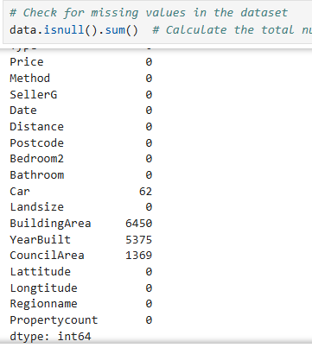
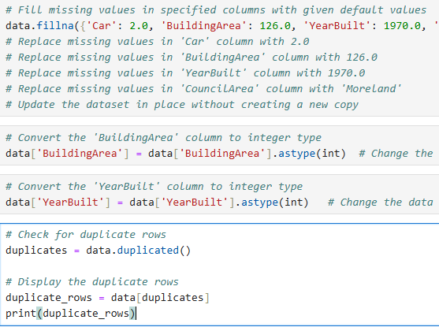
DATA CLEANING
To ensure the integrity of the data, missing values in critical columns like car, BuildingArea, YearBuilt, and CouncilArea were filled with default or calculated values. Missing values in Car, BuildingArea, and YearBuild has been replaced by median of these columns and missing values in CouncilArea has been replace by mode.
After imputing the missing values, the column, BuildingArea, and YearBuilt were converted into integer types to maintain consistency in the data format.
Checking and Handling Duplicates
Duplicate rows can introduce bias and inaccuracies in the dataset. We identified and displayed the duplicate rows using the Pandas duplicated() function. This ensures that any repeated entries do not skew the analysis.

Slide 7
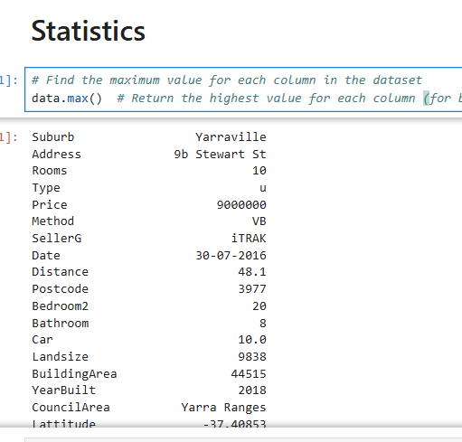
STATISTICS
Mean: The average values of numeric columns such as Price, Rooms, and BuidingArea were calculated, providing insight into the general magnitude of these variables.
Median: The median was calculated for numerical columns to capture the central value in the distribution, which is particularly useful when dealing with skewed data or outliers.
Mode: For categorical columns like CouncilArea, the mode was computed to determine the most frequently occurring category, helping to identify common trends across the data.
A correlation matrix was generated to explore the relationships between different numerical variables, helping to understand which features have the strongest linear relationship with Price.
For example, a high positive correlation between Rooms and Price indicates that properties with more rooms generally tend to have higher prices.The Pearson correlation coefficient was also calculated between specific variables like Landsize and Price, providing a clear picture of how land size influences property prices.

Slide 8
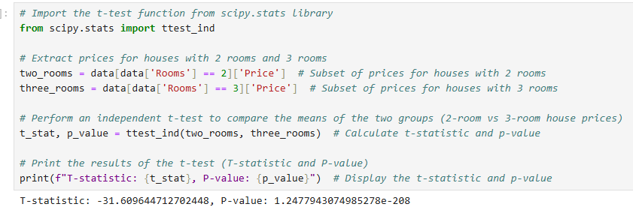
HyPOTHESIS TESTING
initializes a PCA object named pcs
As the p-value is less than your significance level (0.05), reject the null hypothesis, indicating that the number of rooms significantly impacts house prices. However, if the p-value is greater than 0.05, you fail to reject the null hypothesis, meaning the number of rooms may not significantly affect house prices.
A t-statistic of -31.61 is a very large negative value, which suggests a significant difference between the two groups being compared. The negative sign just indicates the direction of the difference, but the magnitude of the t-statistic (the size of the number) is what's important.In general, the larger the absolute value of the t-statistic mean there are more evidence against the null hypothesis (the assumption that there is no difference between the groups).

Slide 9
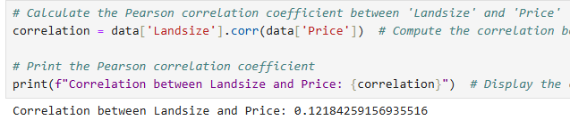
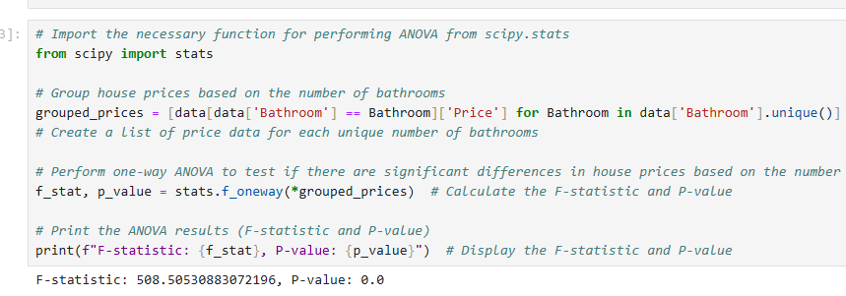
CORRELATION AND ANOVA (Analysis of Variance) ANALYSIS.
In this case, the value 0.1218 is positive but very close to zero. This indicates a weak positive correlation between land size and price. A weak positive correlation means that as land size increases, price tends to increase, but the relationship is not strong.
A large F-statistic (like 508.51) suggests that the independent variables explain a significant portion of the variation in house prices. In other words, your model does a good job of predicting prices based on the features you've included. The F-statistic measures how much of the variation in the dependent variable can be explained by the independent variables in your model, compared to the unexplained variation.

Slide 10
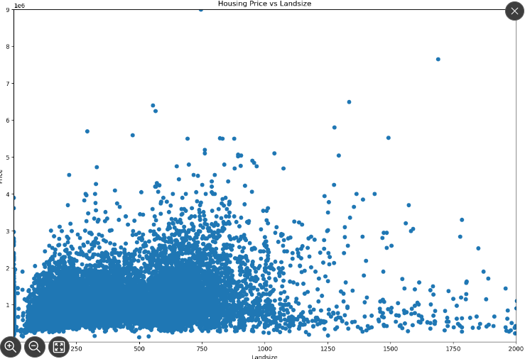
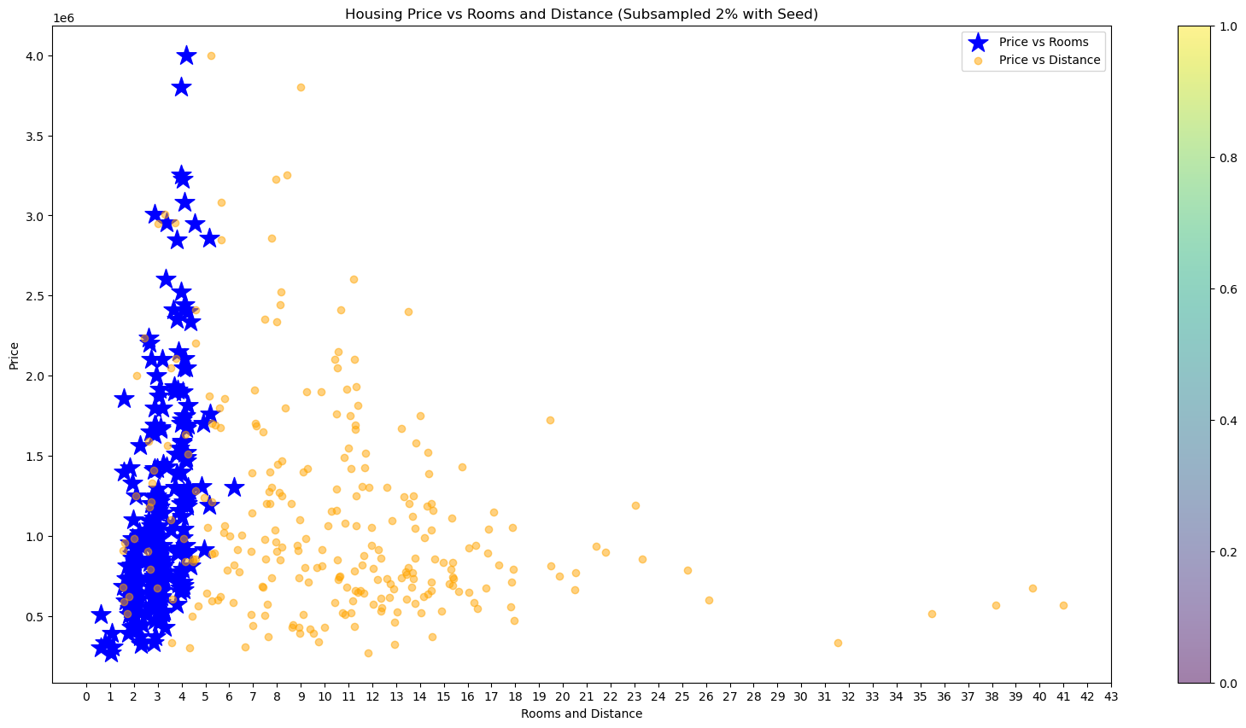
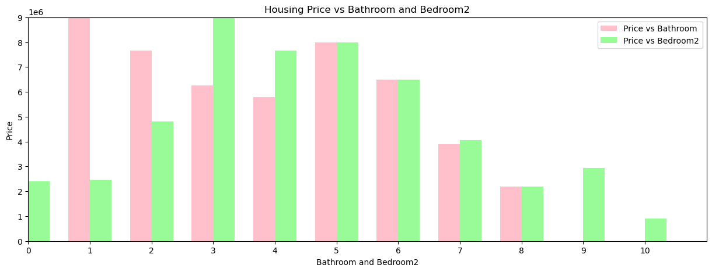
DATA VISUALIZATION
This scatter plot visualizes the relationship between Housing Price and land size. The data shows a general positive trend but with significant variance. Properties with larger land sizes tend to have higher prices, but there are notable outliers. The concentration of properties under 1000 square meters indicates that smaller land sizes are more common in the dataset, yet they exhibit a wide range of prices.
This plot highlights the relationship between Housing Price, the number of Rooms, and Distance from the Central Business District (CBD). The analysis shows that properties closer to the CBD with 3-5 rooms generally have higher prices. As distance increases, housing prices drop significantly, indicating that proximity to urban centers plays a more substantial role than the number of rooms alone.
This bar chart compares the impact of Number of Bathrooms and Bedrooms (Bedroom2) on Housing Price. The data shows that properties with 3-5 bathrooms or bedrooms generally have higher prices, with bathrooms having a slightly stronger correlation with price. However, larger properties with more rooms (e.g., 7 bedrooms) do not necessarily command higher prices, possibly due to niche market demand or diminishing returns on size.

Slide 11
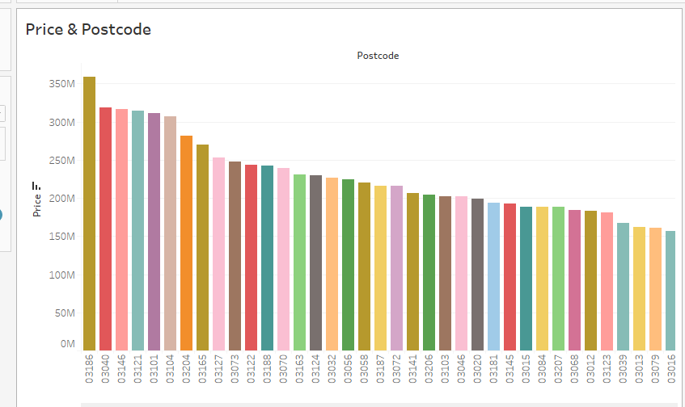
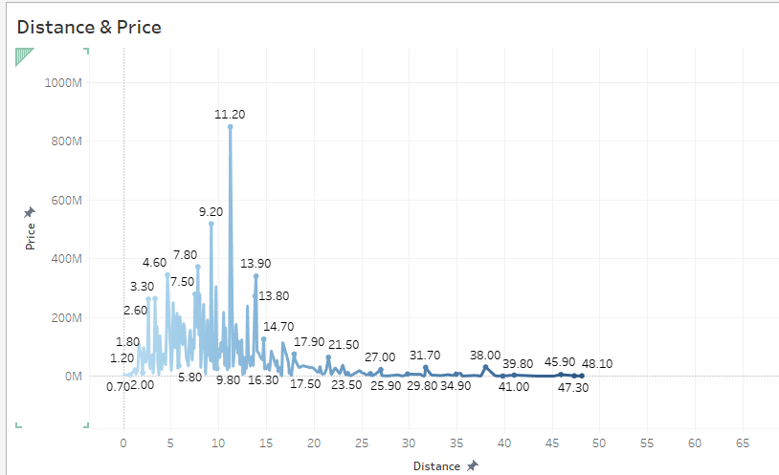
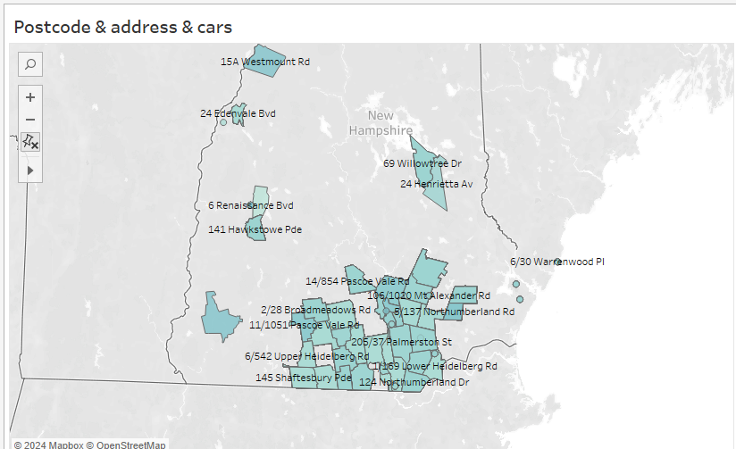
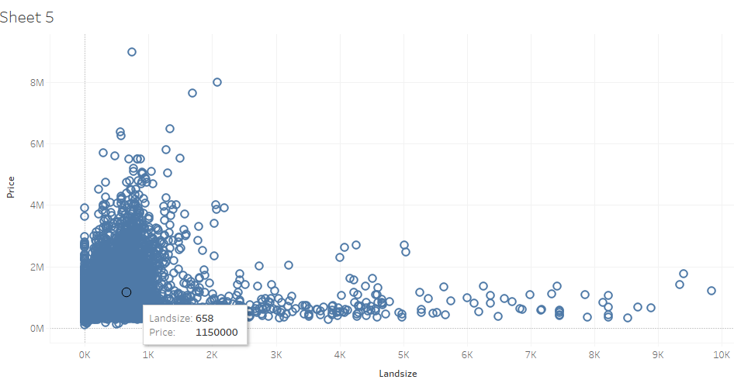
DATA VISUALIZATION ON TABLEAU
This bar chart displays the total property price aggregated by postcode. The highest property prices are concentrated in postcodes 03186 and 03146, indicating areas where real estate is particularly expensive. Postcodes with lower aggregate prices likely represent less affluent areas or locations with lower housing demand.
This geographical visualization maps property addresses, postcodes, and the number of cars. Larger properties or those in more affluent postcodes are often associated with greater car ownership. This indicates that wealthier areas tend to have larger households or higher car ownership, correlating with property values.
This line chart reveals the relationship between Distance from the Central Business District (CBD) and Price. Prices tend to peak around 5 to 15 kilometers from the CBD, indicating a sweet spot where properties are highly valued due to their proximity to urban centers without the high congestion of inner-city areas. Beyond 20 kilometers, property prices drop significantly, showing that distance from the city is a major price determinant.

Slide 12
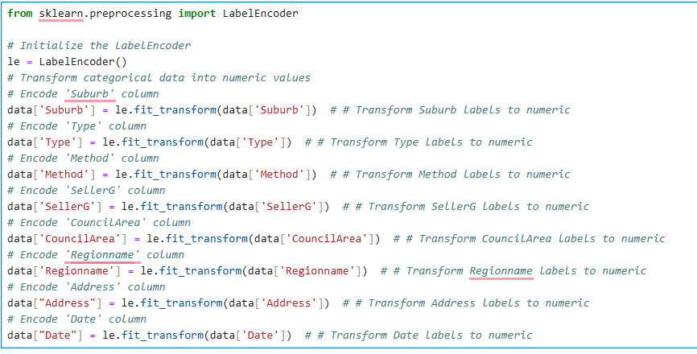
Data Preprocessing - Label Encoding
This code snippet demonstrates the use of Label Encoding to convert categorical variables into numeric values. Label encoding is an essential step in data preprocessing for machine learning, as many algorithms require numerical Inputs.
This same process is repeated for other categorical columns such as:
Type: Property type (house, unit, etc.)
Method: Selling method (auction, private sale, etc.)
SellerG: The real estate agency
CouncilArea: Local government area
Regionname: Geographical region
Address: Property address
Date: Date of sale

Slide 13
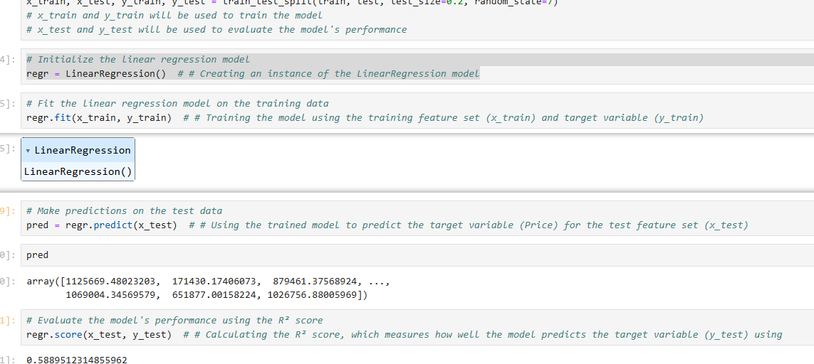
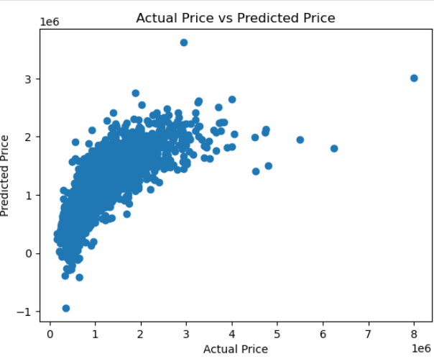
Linear Regression
Predicted Values: The model successfully predicted housing prices for the test data. Example predictions include prices such as 1,125,669, 171,430, and 879,461, which reflect a range of property values. 58.9% of the variance in housing price.
R² Score: The model achieved an R² score of 0.589, which indicates that approximately es is explained by the model. While this score suggests that the model captures a significant portion of the price variance, there is still room for improvement. The relatively moderate R² score may indicate that additional features or more complex models (such as Random Forest or Gradient Boosting) could further improve prediction accuracy.
The linear regression model provides a baseline for predicting housing prices, capturing a substantial amount of variance in the data.

Slide 14
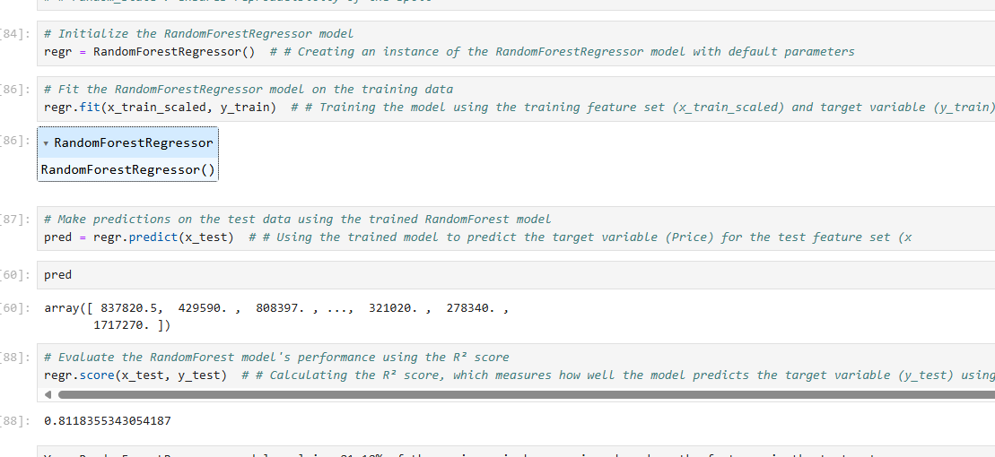
Radom forest Model
Your RandomForestRegressor model explains 81.18% of the variance in house prices based on the features in the test set.This means the model is capturing most of the important relationships between the features and the target variable, making it a strong predictive model.Compared to your linear regression model (which had an R² score of 0.59), this is a significant jump in performance, suggesting that the Random Forest model is better suited to the data. Random Forests excel at capturing complex, non-linear relationships, which might explain why it outperforms linear regression.While 81.18% of the variance is explained, there’s still room for improvement. You could try tuning the hyperparameters of the RandomForestRegressor (e.g., n_estimators, max_depth, min_samples_split) to push the performance even higher.

Slide 15
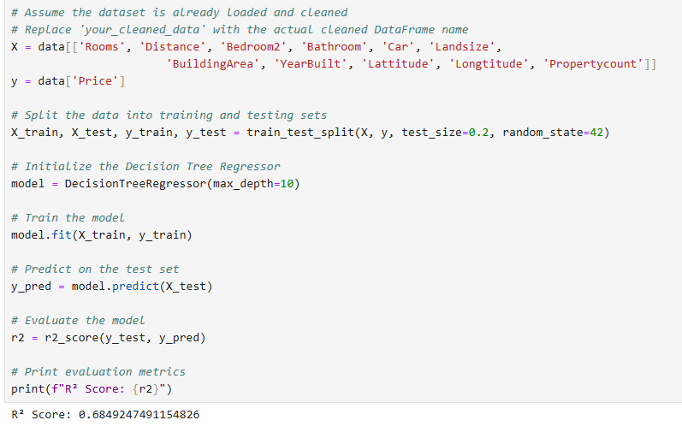
Decision TREE
The decision tree regressor is a popular and interpretable machine learning model used for both regression and classification tasks. In this project, a decision tree model was implemented to predict housing prices based on several features such as the number of rooms, distance from the city, land size, and property count.
The model achieved an R² score of 0.684, meaning that 68.4% of the variance in housing prices is explained by the model. This score reflects a reasonably good fit, indicating that the decision tree captures a significant portion of the variation in housing prices.
The decision tree model offers a more accurate prediction of housing prices compared to linear regression, as reflected by the higher R² score.

Slide 16
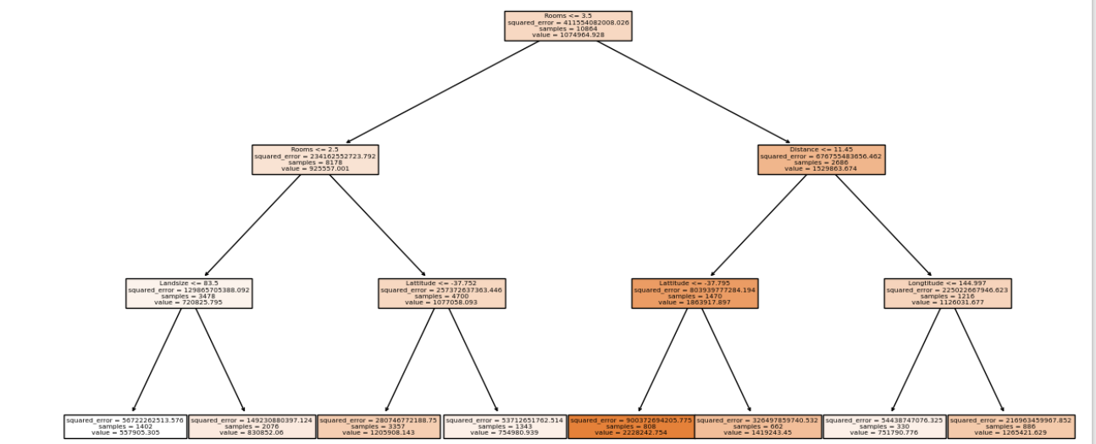
Visualizing the Decision Tree Model
This code snippet demonstrates how to build, train, and visualize a Decision Tree Regressor using Scikit-learn and Matplotlib in Python. The visualization helps us understand the decision-making process of the model and highlights the most important features influencing the predictions.
By visualizing the decision tree, you can identify the most important features influencing the predictions. For instance, features that appear closer to the root of the tree are typically more important for determining the outcome (housing price).

